Slide 1
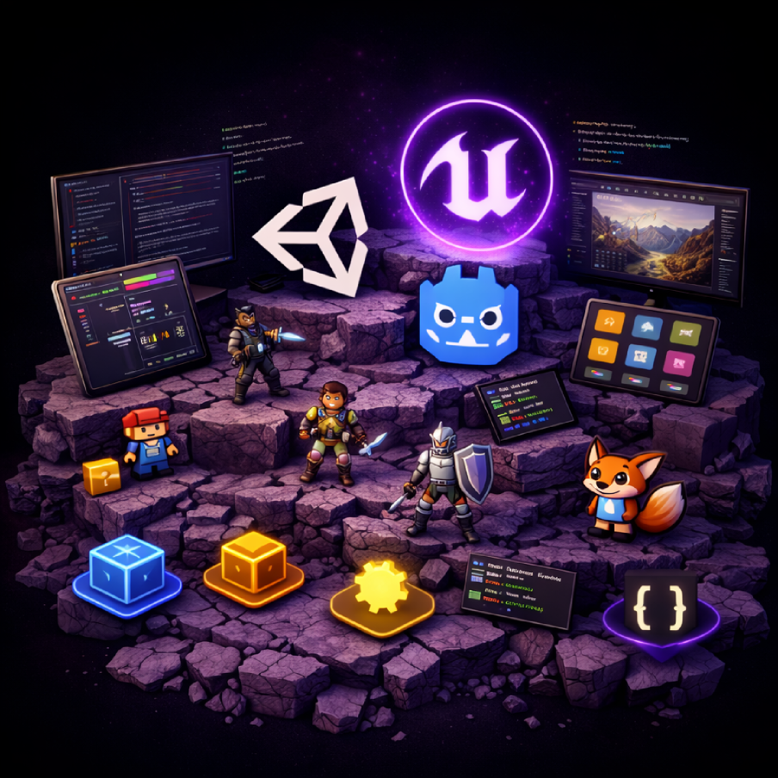
Game Programming, KFUPM
SWE 402, Lecture 4
The Software of Game Dev
Dr. Omar Hammad, KFUPM
Notes:
We've talkd about hardware last lecture, What about software? do I jump Directly to VS code and start building? do I have to use what we call a game engine? What is a game engine? Can I develop games without a game engine? What are the differences between game engines? Which one is better? How can I choose which one to use? this is what we are going to discuss today.

Slide 2
What software do we need to build a game?
Notes:
The first question is: What software do i need in order to build a video game?

Slide 3
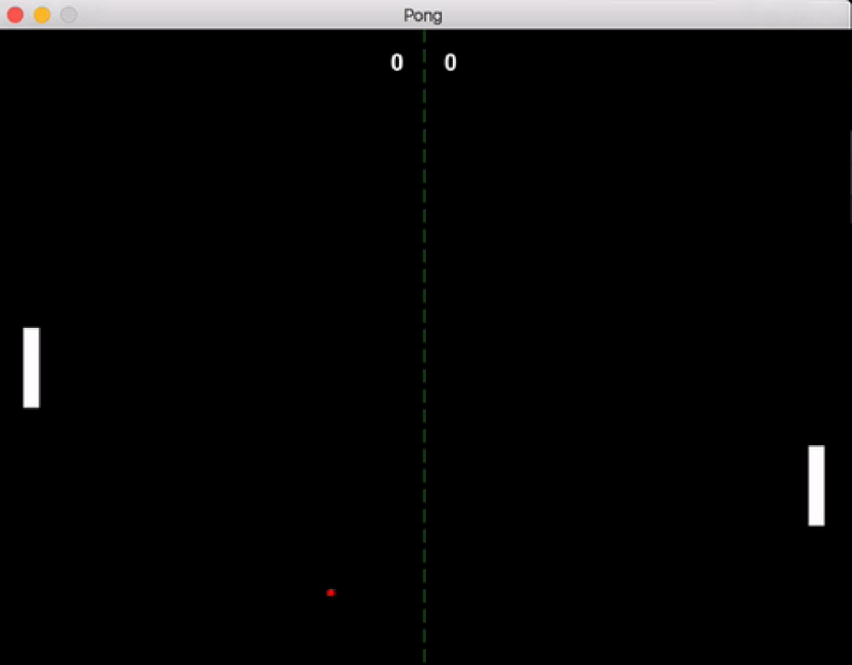
What are the different components?
Notes:
Let's think of a simple game, ping-pong for example. Think of it as a software product.
What are the different elements that ping-pong has?
It has two bars,
a ball,
a score lable,
an algorith to decide if a player hits the ball,
an algorithm (aka a function) to control the opponent,
a function to determine whether a player scores,
and response to keyboard or mouse inputs,
And finally, a sound that appears when the ball hits the bar.

Slide 4
Can you build this using python?
Notes:
Can you build that using Java? Can you build it using C? Can you build it using python? Can you build using HTML, CSS and javascript? Yes, you can.

Slide 5
Is a software platform that provides tools for developers to create video games.
A Game Engine
Notes:
A Game Engine is a software platform that provides tools for developers to create video games.

Slide 6
a Game Engine → ~effeciency
Notes:
So the question is, why do we need game engines? Short answer: efficiency.
A game engine Is basically a bundle of systems you don't have to reinvent.

Slide 7
Why do you need a game engine?
Rendering
Physics
Cameras, Lighting, Shaders..
Collisions, Simulation..
Audio
Input + Builds
Mixing, spatial sound
Controllers + platform export
Notes:
In order to build ping-pong from scratch, you will need to do the following steps:
1. Write the code to render the game
2. Write the code to handle the physics
3. Write the code to handle the audio
4. Write the code to handle the input
5. Write the code to handle the output
6. Write the code to handle the UI
7. Write the code to handle the game logic
However, with a game engine, like Unity for example, you just need to focus on the game logic. The engine will handle the rest.

Slide 8



Which Engine to choose?
Unity
Unreal
Godot
General-purpose
Many platforms
High-end 3D
Big workflows
Lightweight
Open-source
There are more than XXXXXX game engines
Notes:
Different engines come with different workflows and different expectations.
For example, Unity is commonly used across many platforms and project types.
Unreal is known for high-end visuals and big 3D workflows.
Godot is lightweight and open source, and often easier to run on modest hardware.

Slide 9
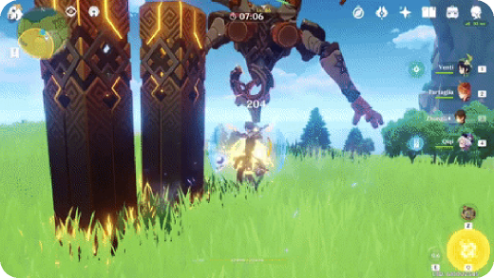


Example of Games By Unity
Notes:
Now, what are some examples of games built with known engines?
Unity examples:
- Among Us (Unity case study)
- Pokémon GO (there is even a dedicated “Unity Architecture in Pokémon Go” talk)
- Genshin Impact (engine listed as Unity

Slide 10
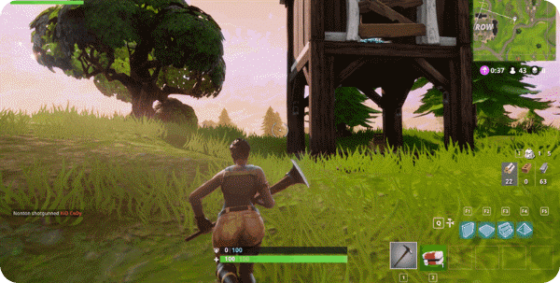
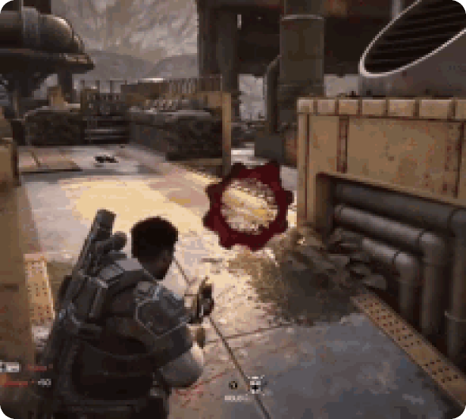

Example of Games By Unreal
Notes:
Unreal examples:
- Epic literally describes Unreal as the tech they use to ship their own games (like Gears of War)
- Gears of War: E‑Day (announced as built in Unreal Engine 5)
- Tekken 7

Slide 11
Do big companies use known game engines or their own code?
Notes:
Now, let me ask you a question, Do companies use game engines or have their own code? Short answer: both.

Slide 12




Custom Game Engines
Anvil by
Re Engine by
Ubisoft
Capcom
Decima by
Frostbite by
Guerrilla
EA
Notes:
Some studios use Unity/Unreal/Godot. Others build an engine in-house because it fits their games perfectly, and it becomes their “factory”.
Examples of companies with in-house engines:
- Ubisoft has Anvil, built for Assassin’s Creed style games.
- Capcom has RE ENGINE, and they explicitly talk about engine + game teams upgrading it together.
- Guerrilla has Decima, powering big titles like Horizon and also used with Kojima Productions.
- EA has Frostbite, used across multiple EA studios.

Slide 13
Why do they invest in creating their own game engines?
Notes:
Why do they do that?

Slide 14




Benefits of Custom Game Engines
Long Term Investment
Standardize tools across teams
Control performance
Build Custom workflows
Notes:
Because engines are not just “graphics”.
A company engine is:
- a long-term investment
- a way to standardize tools across teams
- a way to control performance and memory for specific game types
- a way to build custom workflows for designers, artists, animators, and QA

Slide 15
What are the downsides of using a game engine?
Notes:
Finally, an important point to note is that game engines have downside also, like any library/framework/tool. Such as the learning curve, cost, overhead, and more. However, the benefits outweigh the drawbacks for most cases, especially for complex games.

Slide 16
Is an Engine enough or do we need other tools?
Notes:
But wait, Are we going to use game engines alone or are we going to use them with a set of other tools?
For instance, are we going to write code inside of unity?
Are we going to model our objects inside Unity?
Are we going to create sounds inside of Unity?
Or do we need specialized tools in order to build these?

Slide 17




A typical game dev toolchain
3D Modeling
2D Art
Blender.. etc.
Photoshop.. etc.
Scripting
Audio
VS Code.. etc.
Audacity.. etc.
Notes:
For sure, we will need specialized tools in order to build these. So unity is used along with other tools like Blender, Audacity, etc.

Slide 18


Game Programming, KFUPM
By Dr. Omar Hammad
join the discussion
discord.gg/jSyF3RJS
Thank you

